Slide 1
Note to other teachers and users of these slides. Andrew would be delighted if you found this source material useful in giving your own lectures. Feel free to use these slides verbatim, or to modify them to fit your own needs. PowerPoint originals are available. If you make use of a significant portion of these slides in your own lecture, please include this message, or the following link to the source repository of Andrew’s tutorials: http://www.cs.cmu.edu/~awm/tutorials .
Comments and corrections gratefully received.
Decision Trees
Andrew W. Moore Professor
School of Computer Science Carnegie Mellon University
www.cs.cmu.edu/~awm awm@cs.cmu.edu
412-268-7599
Copyright © Andrew W. Moore
Slide 1
Machine Learning Datasets What is Classification?
Contingency Tables
OLAP (Online Analytical Processing) What is Data Mining?
Searching for High Information Gain
Learning an unpruned decision tree recursively Training Set Error
Test Set Error Overfitting Avoiding Overfitting
Information Gain of a real valued input Building Decision Trees with real Valued Inputs
Andrew’s homebrewed hack: Binary Categorical Splits Example Decision Trees
Copyright © Andrew W. Moore
Slide 2

Slide 2
Here is a dataset
age | employme | education | edun | marital | … | job | relation | race | gender | hour | country | wealth
 |  |  |  |  | …
39 | State_gov | Bachelors | 13 | Never_mar | … | Adm_cleri | Not_in_fam | White | Male | 40 | United_Sta | poor
51 | Self_emp_ | Bachelors | 13 | Married | … | Exec_man | Husband | White | Male | 13 | United_Sta | poor
39 | Private | HS_grad | 9 | Divorced | … | Handlers_ | Not_in_fam | White | Male | 40 | United_Sta | poor
54 | Private | 11th | 7 | Married | … | Handlers_ | Husband | Black | Male | 40 | United_Sta | poor
28 | Private | Bachelors | 13 | Married | … | Prof_speci | Wife | Black | Female | 40 | Cuba | poor
38 | Private | Masters | 14 | Married | … | Exec_man | Wife | White | Female | 40 | United_Sta | poor
50 | Private | 9th | 5 | Married_sp | … | Other_serv | Not_in_fam | Black | Female | 16 | Jamaica | poor
52 | Self_emp_ | HS_grad | 9 | Married | … | Exec_man | Husband | White | Male | 45 | United_Sta | rich
31 | Private | Masters | 14 | Never_mar | … | Prof_speci | Not_in_fam | White | Female | 50 | United_Sta | rich
42 | Private | Bachelors | 13 | Married | … | Exec_man | Husband | White | Male | 40 | United_Sta | rich
37 | Private | Some_coll | 10 | Married | … | Exec_man | Husband | Black | Male | 80 | United_Sta | rich
30 | State_gov | Bachelors | 13 | Married | … | Prof_speci | Husband | Asian | Male | 40 | India | rich
24 | Private | Bachelors | 13 | Never_mar | … | Adm_cleri | Own_child | White | Female | 30 | United_Sta | poor
33 | Private | Assoc_ac | 12 | Never_mar | … | Sales | Not_in_fam | Black | Male | 50 | United_Sta | poor
41 | Private | Assoc_voc | 11 | Married | … | Craft_repai | Husband | Asian | Male | 40 | *MissingV | rich
34 | Private | 7th_8th | 4 | Married | … | Transport_ | Husband | Amer_Indi | Male | 45 | Mexico | poor
26 | Self_emp_ | HS_grad | 9 | Never_mar | … | Farming_fi | Own_child | White | Male | 35 | United_Sta | poor
33 | Private | HS_grad | 9 | Never_mar | … | Machine_o | Unmarried | White | Male | 40 | United_Sta | poor
38 | Private | 11th | 7 | Married | … | Sales | Husband | White | Male | 50 | United_Sta | poor
44 | Self_emp_ | Masters | 14 | Divorced | … | Exec_man | Unmarried | White | Female | 45 | United_Sta | rich
41 | Private | Doctorate | 16 | Married | … | Prof_speci | Husband | White | Male | 60 | United_Sta | rich
: | : | : | : | : | : | : | : | : | : | : | : | :
48,000 records, 16 attributes [Kohavi 1995]
Copyright © Andrew W. Moore
Slide 3
Machine Learning Datasets What is Classification?
Contingency Tables
OLAP (Online Analytical Processing) What is Data Mining?
Searching for High Information Gain
Learning an unpruned decision tree recursively Training Set Error
Test Set Error Overfitting Avoiding Overfitting
Information Gain of a real valued input Building Decision Trees with real Valued Inputs
Andrew’s homebrewed hack: Binary Categorical Splits Example Decision Trees
Copyright © Andrew W. Moore
Slide 4

Slide 3
Classification
A Major Data Mining Operation
Give one attribute (e.g wealth), try to predict the value of new people’s wealths by means of some of the other available attributes.
Applies to categorical outputs
Categorical attribute: an attribute which takes on two or more discrete values. Also known as a symbolic attribute.
Real attribute: a column of real numbers
Copyright © Andrew W. Moore
Slide 5
Today’s lecture
Information Gain for measuring association between inputs and outputs
Learning a decision tree classifier from data
Copyright © Andrew W. Moore
Slide 6

Slide 4
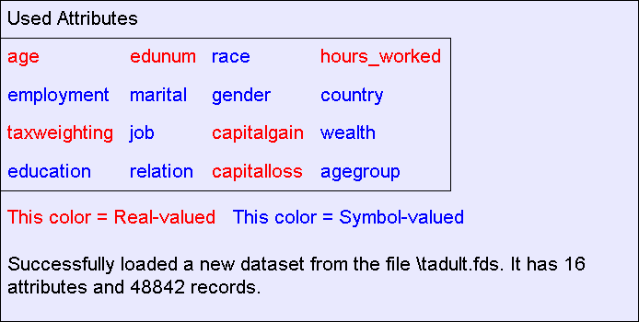
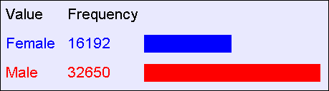
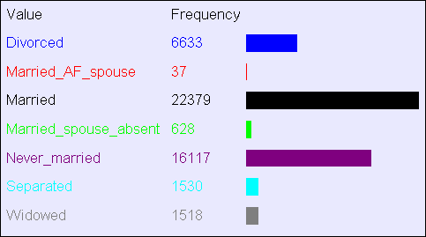
About this dataset
It is a tiny subset of the 1990 US Census.
It is publicly available online from the UCI Machine Learning Datasets repository
Copyright © Andrew W. Moore
Slide 7
What can you do with a dataset?
Well, you can look at histograms…
Gender
Marital Status
Copyright © Andrew W. Moore
Slide 8

Slide 5
Machine Learning Datasets What is Classification?
Contingency Tables
OLAP (Online Analytical Processing) What is Data Mining?
Searching for High Information Gain
Learning an unpruned decision tree recursively Training Set Error
Test Set Error Overfitting Avoiding Overfitting
Information Gain of a real valued input Building Decision Trees with real Valued Inputs
Andrew’s homebrewed hack: Binary Categorical Splits Example Decision Trees
Copyright © Andrew W. Moore
Slide 9
Contingency Tables
A better name for a histogram:
A One-dimensional Contingency Table
Recipe for making a k-dimensional contingency table:
Pick k attributes from your dataset. Call them a₁,a₂, … a_{k}.
For every possible combination of values, a₁,=x₁, a₂,=x₂,… a_{k},=x_{k} ,record how frequently that combination occurs
Fun fact: A database person would call this a “k-dimensional datacube”
Copyright © Andrew W. Moore
Slide 10

Slide 6
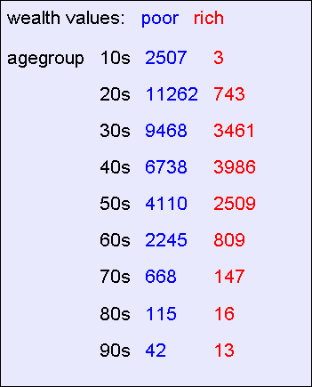
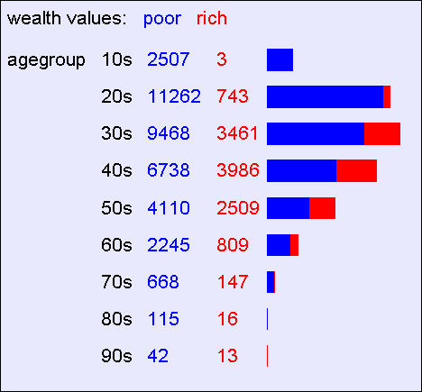
A 2-d Contingency Table
For each pair of values for attributes (agegroup,wealth) we can see how many records match.
Copyright © Andrew W. Moore
Slide 11
A 2-d Contingency Table
Easier to appreciate graphically
Copyright © Andrew W. Moore
Slide 12

Slide 7
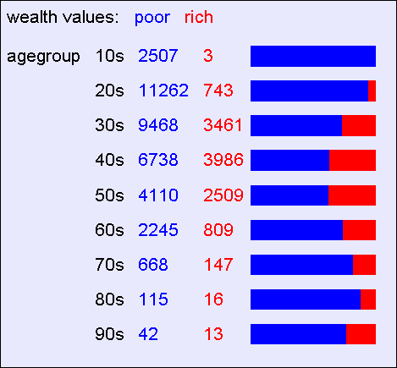
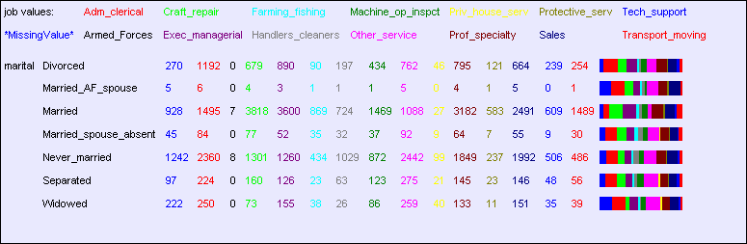
A 2-d Contingency Table
Easier to see “interesting” things if we stretch out the histogram bars
Copyright © Andrew W. Moore
Slide 13
A bigger 2-d contingency table
Copyright © Andrew W. Moore
Slide 14

Slide 8
3-d contingency tables
These are harder to look at!
Poor
20s 30s 40s 50s
Rich
Male
Female
Copyright © Andrew W. Moore
Slide 15
Machine Learning Datasets What is Classification?
Contingency Tables
OLAP (Online Analytical Processing) What is Data Mining?
Searching for High Information Gain
Learning an unpruned decision tree recursively Training Set Error
Test Set Error Overfitting Avoiding Overfitting
Information Gain of a real valued input Building Decision Trees with real Valued Inputs
Andrew’s homebrewed hack: Binary Categorical Splits Example Decision Trees
Copyright © Andrew W. Moore
Slide 16

Slide 9
On-Line Analytical Processing (OLAP)
Software packages and database add-ons to do this are known as OLAP tools
They usually include point and click navigation to view slices and aggregates of contingency tables
They usually include nice histogram visualization
Copyright © Andrew W. Moore
Slide 17
Time to stop and think
Why would people want to look at contingency tables?
Copyright © Andrew W. Moore
Slide 18

Slide 10
Let’s continue to think
With 16 attributes, how many 1-d contingency tables are there?
How many 2-d contingency tables?
How many 3-d tables?
With 100 attributes how many 3-d tables are there?
Copyright © Andrew W. Moore
Slide 19
Let’s continue to think
With 16 attributes, how many 1-d contingency tables are there? 16
How many 2-d contingency tables? 16- choose-2 = 16 * 15 / 2 = 120
How many 3-d tables? 560
With 100 attributes how many 3-d tables are there? 161,700
Copyright © Andrew W. Moore
Slide 20

Slide 11
Manually looking at contingency tables
Looking at one contingency table: can be as much fun as reading an interesting book
Looking at ten tables: as much fun as watching CNN
Looking at 100 tables: as much fun as watching an infomercial
Looking at 100,000 tables: as much fun as a three- week November vacation in Duluth with a dying weasel.
Copyright © Andrew W. Moore
Slide 21
Machine Learning Datasets What is Classification?
Contingency Tables
OLAP (Online Analytical Processing) What is Data Mining?
Searching for High Information Gain
Learning an unpruned decision tree recursively Training Set Error
Test Set Error Overfitting Avoiding Overfitting
Information Gain of a real valued input Building Decision Trees with real Valued Inputs
Andrew’s homebrewed hack: Binary Categorical Splits Example Decision Trees
Copyright © Andrew W. Moore
Slide 22

Slide 12
Data Mining
Data Mining is all about automating the process of searching for patterns in the data.
Which patterns are interesting? Which might be mere illusions? And how can they be exploited?
Copyright © Andrew W. Moore
Slide 23
Data Mining
Data Mining is all about automating the process of searching for patterns in the data.
That’s what we’ll look at right now.
Which patterns are interesting?
And the answer will turn out to be the engine that drives decision tree learning.
Which might be mere illusions? And how can they be exploited?
Copyright © Andrew W. Moore
Slide 24

Slide 13
Deciding whether a pattern is interesting
We will use information theory
A very large topic, originally used for compressing signals
But more recently used for data mining…
Copyright © Andrew W. Moore
Slide 25
Deciding whether a pattern is interesting
We will use information theory
A very large topic, originally used for compressing signals
But more recently used for data mining…
(The topic of Information Gain will now be discussed, but you will find it in a separate
Andrew Handout)
Copyright © Andrew W. Moore
Slide 26

Slide 14
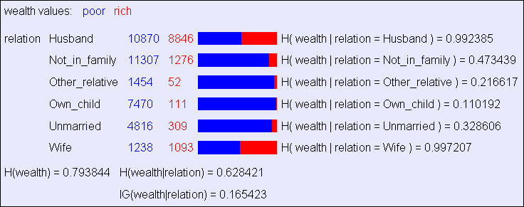
Machine Learning Datasets What is Classification?
Contingency Tables
OLAP (Online Analytical Processing) What is Data Mining?
Searching for High Information Gain
Learning an unpruned decision tree recursively Training Set Error
Test Set Error Overfitting Avoiding Overfitting
Information Gain of a real valued input Building Decision Trees with real Valued Inputs
Andrew’s homebrewed hack: Binary Categorical Splits Example Decision Trees
Copyright © Andrew W. Moore
Slide 27
Searching for High Info Gains
Given something (e.g. wealth) you are trying to predict, it is easy to ask the computer to find which attribute has highest information gain for it.
Copyright © Andrew W. Moore
Slide 28

Slide 15
Machine Learning Datasets What is Classification?
Contingency Tables
OLAP (Online Analytical Processing) What is Data Mining?
Searching for High Information Gain
Learning an unpruned decision tree recursively Training Set Error
Test Set Error Overfitting Avoiding Overfitting
Information Gain of a real valued input Building Decision Trees with real Valued Inputs
Andrew’s homebrewed hack: Binary Categorical Splits Example Decision Trees
Copyright © Andrew W. Moore
Slide 29
Learning Decision Trees
A Decision Tree is a tree-structured plan of a set of attributes to test in order to predict the output.
To decide which attribute should be tested first, simply find the one with the highest information gain.
Then recurse…
Copyright © Andrew W. Moore
Slide 30

Slide 16
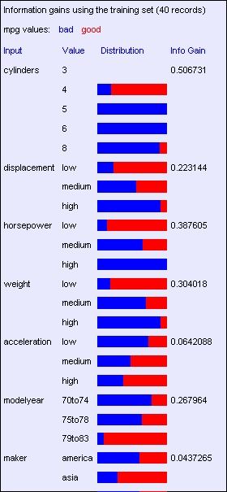
A small dataset: Miles Per Gallon
mpg | cylinders | displacement | horsepower | weight | acceleration | modelyear | maker
good | 4 | low | low | low | high | 75to78 | asia
bad | 6 | medium | medium | medium | medium | 70to74 | america
bad | 4 | medium | medium | medium | low | 75to78 | europe
bad | 8 | high | high | high | low | 70to74 | america
bad | 6 | medium | medium | medium | medium | 70to74 | america
bad | 4 | low | medium | low | medium | 70to74 | asia
bad | 4 | low | medium | low | low | 70to74 | asia
bad | 8 | high | high | high | low | 75to78 | america
: | : | : | : | : | : | : | :
: | : | : | : | : | : | : | :
: | : | : | : | : | : | : | :
bad | 8 | high | high | high | low | 70to74 | america
good | 8 | high | medium | high | high | 79to83 | america
bad | 8 | high | high | high | low | 75to78 | america
good | 4 | low | low | low | low | 79to83 | america
bad | 6 | medium | medium | medium | high | 75to78 | america
good | 4 | medium | low | low | low | 79to83 | america
good | 4 | low | low | medium | high | 79to83 | america
bad | 8 | high | high | high | low | 70to74 | america
good | 4 | low | medium | low | medium | 75to78 | europe
bad | 5 | medium | medium | medium | medium | 75to78 | europe
40
Records
From the UCI repository (thanks to Ross Quinlan)
Copyright © Andrew W. Moore
Slide 31
Suppose we want to predict MPG.
Look at all the information gains…
Copyright © Andrew W. Moore
Slide 32

Slide 17
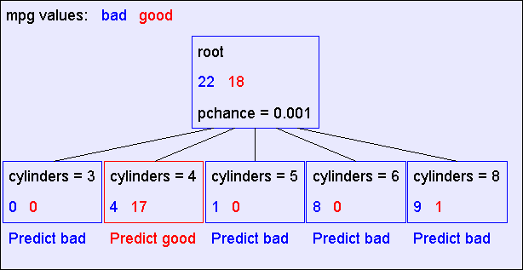
A Decision Stump
Copyright © Andrew W. Moore
Slide 33
Recursion Step
Records in which cylinders
= 4
Records in which cylinders
= 5
Take the Original Dataset..
And partition it according
to the value of the attribute we split on
Records in which cylinders
= 6
Records in which cylinders
= 8
Copyright © Andrew W. Moore
Slide 34

Slide 18
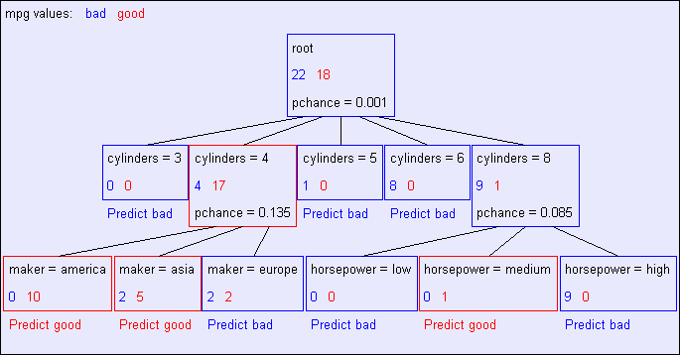
Recursion Step
Build tree from These records..
Build tree from These records..
Build tree from Build tree from These records.. These records..
Records in which cylinders = 6
Records in which cylinders = 8
Records in which cylinders = 4
Records in
which cylinders = 5
Copyright © Andrew W. Moore
Slide 35
Second level of tree
Recursively build a tree from the seven records in which there are four cylinders and the maker was based in Asia
(Similar recursion in the other cases)
Copyright © Andrew W. Moore
Slide 36

Slide 19
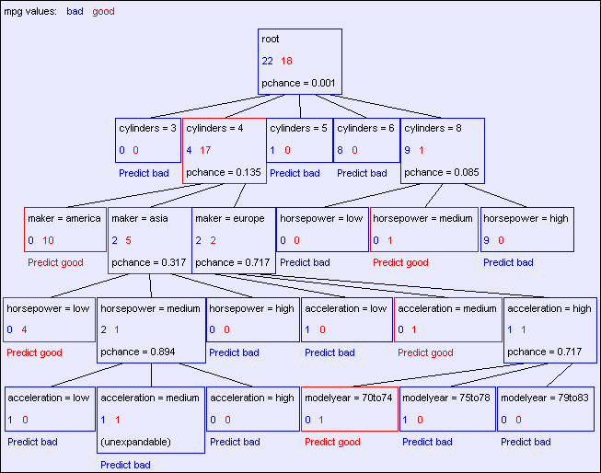
The final tree
Copyright © Andrew W. Moore Slide 37
 | Base Case One
Don’t split a node if all matching records have the same output value Copyright © Andrew W. Moore Slide 38

Slide 20
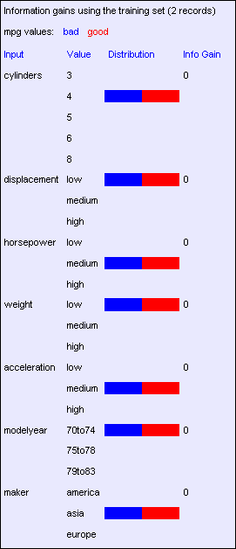
 | Base Case Two
Don’t split a node if none of the attributes can create multiple non- empty children Copyright © Andrew W. Moore Slide 39
Base Case Two: No attributes can distinguish
Copyright © Andrew W. Moore
Slide 40

Slide 21
Base Cases
Base Case One: If all records in current data subset have the same output then don’t recurse
Base Case Two: If all records have exactly the same set of input attributes then don’t recurse
Copyright © Andrew W. Moore
Slide 41
Base Cases: An idea
Base Case One: If all records in current data subset have the same output then don’t recurse
Base Case Two: If all records have exactly the same set of input attributes then don’t recurse
Proposed Base Case 3:
If all attributes have zero information gain then don’t recurse
Is this a good idea?
Copyright © Andrew W. Moore
Slide 42

Slide 22
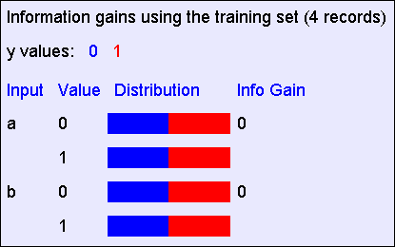
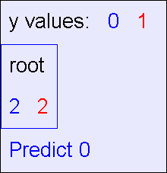
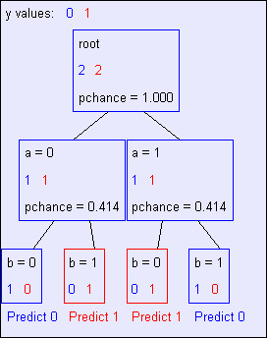
The problem with Base Case 3
a | b | y
0 | 0 | 0
0 | 1 | 1
1 | 0 | 1
1 | 1 | 0
y = a XOR b
The information gains:
The resulting decision tree:
Copyright © Andrew W. Moore
Slide 43
If we omit Base Case 3:
a | b | y
0 | 0 | 0
0 | 1 | 1
1 | 0 | 1
1 | 1 | 0
y = a XOR b
The resulting decision tree:
Copyright © Andrew W. Moore
Slide 44

Slide 23
Basic Decision Tree Building Summarized
BuildTree(DataSet,Output)
If all output values are the same in DataSet, return a leaf node that says “predict this unique output”
If all input values are the same, return a leaf node that says “predict the majority output”
Else find attribute X with highest Info Gain
Suppose X has n_{X} distinct values (i.e. X has arity n_{X}).
Create and return a non-leaf node with n_{X} children.
The i’th child should be built by calling
BuildTree(DS_{i},Output)
Where DS_{i} built consists of all those records in DataSet for which X = ith distinct value of X.
Copyright © Andrew W. Moore
Slide 45
Machine Learning Datasets What is Classification?
Contingency Tables
OLAP (Online Analytical Processing) What is Data Mining?
Searching for High Information Gain
Learning an unpruned decision tree recursively Training Set Error
Test Set Error Overfitting Avoiding Overfitting
Information Gain of a real valued input Building Decision Trees with real Valued Inputs
Andrew’s homebrewed hack: Binary Categorical Splits Example Decision Trees
Copyright © Andrew W. Moore
Slide 46

Slide 24
Training Set Error
For each record, follow the decision tree to see what it would predict
For what number of records does the decision tree’s prediction disagree with the true value in the database?
This quantity is called the training set error. The smaller the better.
Copyright © Andrew W. Moore
Slide 47
 |  |  |  |  | MPG Training error
Copyright | © | Andrew | W. | Moore | Slide | 48

Slide 25

 |  |  |  |  | MPG Training error
Copyright | © | Andrew | W. | Moore | Slide | 49
 |  |  |  |  | MPG Training error
Copyright | © | Andrew | W. | Moore | Slide | 50

Slide 26
Stop and reflect: Why are we doing this learning anyway?
It is not usually in order to predict the training data’s output on data we have already seen.
Copyright © Andrew W. Moore
Slide 51
Stop and reflect: Why are we doing this learning anyway?
It is not usually in order to predict the training data’s output on data we have already seen.
It is more commonly in order to predict the output value for future data we have not yet seen.
Copyright © Andrew W. Moore
Slide 52

Slide 27
Stop and reflect: Why are we doing this learning anyway?
It is not usually in order to predict the training data’s output on data we have already seen.
It is more commonly in order to predict the output value for future data we have not yet seen.
Warning: A common data mining misperception is that the above two bullets are the only possible reasons for learning. There are at least a dozen others.
Copyright © Andrew W. Moore
Slide 53
Machine Learning Datasets What is Classification?
Contingency Tables
OLAP (Online Analytical Processing) What is Data Mining?
Searching for High Information Gain
Learning an unpruned decision tree recursively Training Set Error
Test Set Error Overfitting Avoiding Overfitting
Information Gain of a real valued input Building Decision Trees with real Valued Inputs
Andrew’s homebrewed hack: Binary Categorical Splits Example Decision Trees
Copyright © Andrew W. Moore
Slide 54

Slide 28
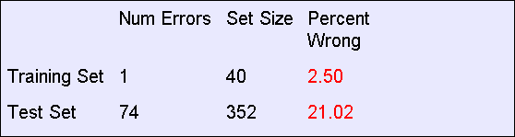
Test Set Error
Suppose we are forward thinking.
We hide some data away when we learn the decision tree.
But once learned, we see how well the tree predicts that data.
This is a good simulation of what happens when we try to predict future data.
And it is called Test Set Error.
Copyright © Andrew W. Moore
Slide 55
MPG Test set error
Copyright © Andrew W. Moore
Slide 56

Slide 29
 | MPG Test set error
The test set error is much worse than the training set error… …why? Copyright © Andrew W. Moore Slide 57
Machine Learning Datasets What is Classification?
Contingency Tables
OLAP (Online Analytical Processing) What is Data Mining?
Searching for High Information Gain
Learning an unpruned decision tree recursively Training Set Error
Test Set Error Overfitting Avoiding Overfitting
Information Gain of a real valued input Building Decision Trees with real Valued Inputs
Andrew’s homebrewed hack: Binary Categorical Splits Example Decision Trees
Copyright © Andrew W. Moore
Slide 58

Slide 30
An artificial example
We’ll create a training dataset
Five inputs, all bits, are generated in all 32 possible combinations
Output y = copy of e, Except a random 25% of the records have y set to the opposite of e
a | b | c | d | e | y
0 | 0 | 0 | 0 | 0 | 0
0 | 0 | 0 | 0 | 1 | 0
0 | 0 | 0 | 1 | 0 | 0
0 | 0 | 0 | 1 | 1 | 1
0 | 0 | 1 | 0 | 0 | 1
: | : | : | : | : | :
1 | 1 | 1 | 1 | 1 | 1
32 records
Copyright © Andrew W. Moore
Slide 59
In our artificial example
Suppose someone generates a test set according to the same method.
The test set is identical, except that some of the y’s will be different.
Some y’s that were corrupted in the training set will be uncorrupted in the testing set.
Some y’s that were uncorrupted in the training set will be corrupted in the test set.
Copyright © Andrew W. Moore
Slide 60

Slide 31
Building a tree with the artificial training set
Suppose we build a full tree (we always split until base case 2)
Root
e=0
e=1
a=0
a=1
a=0
a=1
25% of these leaf node labels will be corrupted
Copyright © Andrew W. Moore
Slide 61
Training set error for our artificial tree
All the leaf nodes contain exactly one record and so…
We would have a training set error of zero
Copyright © Andrew W. Moore
Slide 62

Slide 32
Testing the tree with the test set
 | 1/4 of the tree nodes are corrupted | 3/4 are fine
1/4 of the test set records are corrupted | 1/16 of the test set will be correctly predicted for the wrong reasons | 3/16 of the test set will be wrongly predicted because the test record is corrupted
3/4 are fine | 3/16 of the test predictions will be wrong because the tree node is corrupted | 9/16 of the test predictions will be fine
In total, we expect to be wrong on 3/8 of the test set predictions
Copyright © Andrew W. Moore
Slide 63
What’s this example shown us?
This explains the discrepancy between training and test set error
But more importantly… …it indicates there’s something we should do about it if we want to predict well on future data.
Copyright © Andrew W. Moore
Slide 64

Slide 33
Suppose we had less data Let’s not look at the irrelevant bits
These bits are hidden | Output y = copy of e, except a random 25% of the records have y set to the opposite of e
What decision tree would we learn now? Copyright © Andrew W. Moore Slide 65
a | b | c | d | e | y
0 | 0 | 0 | 0 | 0 | 0
0 | 0 | 0 | 0 | 1 | 0
0 | 0 | 0 | 1 | 0 | 0
0 | 0 | 0 | 1 | 1 | 1
0 | 0 | 1 | 0 | 0 | 1
: | : | : | : | : | :
1 | 1 | 1 | 1 | 1 | 1
32 records
Without access to the irrelevant bits…
Root
e=0
e=1
These nodes will be unexpandable
Copyright © Andrew W. Moore
Slide 66

Slide 34
Without access to the irrelevant bits…
Root
e=0
e=1
These nodes will be unexpandable
In about 12 of the 16 records in this node the output will be 0
In about 12 of the 16 records in this node the output will be 1
So this will almost certainly predict 0
Copyright © Andrew W. Moore
So this will almost certainly predict 1
Slide 67
Without access to the irrelevant bits…
Root
 | almost certainly none of the tree nodes are corrupted | almost certainly all are fine
1/4 of the test set records are corrupted | n/a | 1/4 of the test set will be wrongly predicted because the test record is corrupted
3/4 are fine | n/a | 3/4 of the test predictions will be fine
e=0
e=1
In total, we expect to be wrong on only 1/4 of the test set predictions
Copyright © Andrew W. Moore
Slide 68

Slide 35
Overfitting
Definition: If your machine learning algorithm fits noise (i.e. pays attention to parts of the data that are irrelevant) it is overfitting.
Fact (theoretical and empirical): If your machine learning algorithm is overfitting then it may perform less well on test set data.
Copyright © Andrew W. Moore
Slide 69
Machine Learning Datasets What is Classification?
Contingency Tables
OLAP (Online Analytical Processing) What is Data Mining?
Searching for High Information Gain
Learning an unpruned decision tree recursively Training Set Error
Test Set Error Overfitting Avoiding Overfitting
Information Gain of a real valued input Building Decision Trees with real Valued Inputs
Andrew’s homebrewed hack: Binary Categorical Splits Example Decision Trees
Copyright © Andrew W. Moore
Slide 70

Slide 36
Avoiding overfitting
Usually we do not know in advance which are the irrelevant variables
…and it may depend on the context
For example, if y = a AND b then b is an irrelevant variable only in the portion of the tree in which a=0
But we can use simple statistics to warn us that we might be overfitting.
Copyright © Andrew W. Moore
Slide 71
Consider this split
Copyright © Andrew W. Moore
Slide 72

Slide 37
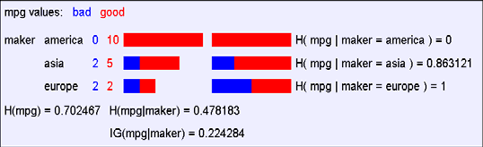
A chi-squared test
Suppose that mpg was completely uncorrelated with maker.
What is the chance we’d have seen data of at least this apparent level of association anyway?
Copyright © Andrew W. Moore
Slide 73
A chi-squared test
Suppose that mpg was completely uncorrelated with maker.
What is the chance we’d have seen data of at least this apparent level of association anyway?
By using a particular kind of chi-squared test, the answer is 13.5%.
Copyright © Andrew W. Moore
Slide 74

Slide 38
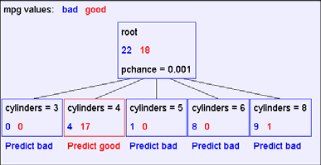
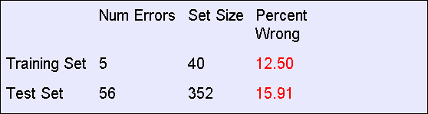
Using Chi-squared to avoid overfitting
Build the full decision tree as before.
But when you can grow it no more, start to prune:
Beginning at the bottom of the tree, delete splits in which p_{chance} > MaxPchance.
Continue working you way up until there are no more prunable nodes.
MaxPchance is a magic parameter you must specify to the decision tree, indicating your willingness to risk fitting noise.
Copyright © Andrew W. Moore
Slide 75
Pruning example
With MaxPchance = 0.1, you will see the following MPG decision tree:
Note the improved test set accuracy compared with the unpruned tree
Copyright © Andrew W. Moore
Slide 76

Slide 39
MaxPchance
Good news: The decision tree can automatically adjust its pruning decisions according to the amount of apparent noise and data.
Bad news: The user must come up with a good value of MaxPchance. (Note, Andrew usually uses 0.05, which is his favorite value for any magic parameter).
Good news: But with extra work, the best MaxPchance value can be estimated automatically by a technique called cross-validation.
Copyright © Andrew W. Moore
Slide 77
MaxPchance
Technical note (dealt with in other lectures): MaxPchance is a regularization parameter.
Expected Test set Error
Decreasing
MaxPchance
Increasing
High Bias
High Variance
Copyright © Andrew W. Moore
Slide 78

Slide 40
The simplest tree
Note that this pruning is heuristically trying to find
The simplest tree structure for which all within-leaf- node disagreements can be explained by chance
This is not the same as saying “the simplest classification scheme for which…”
Decision trees are biased to prefer classifiers that can be expressed as trees.
Copyright © Andrew W. Moore
Slide 79
Expressiveness of Decision Trees
Assume all inputs are Boolean and all outputs are Boolean.
What is the class of Boolean functions that are possible to represent by decision trees?
Answer: All Boolean functions.
Simple proof:
Take any Boolean function
Convert it into a truth table
Construct a decision tree in which each row of the truth table corresponds to one path through the decision tree.
Copyright © Andrew W. Moore
Slide 80

Slide 41
Machine Learning Datasets What is Classification?
Contingency Tables
OLAP (Online Analytical Processing) What is Data Mining?
Searching for High Information Gain
Learning an unpruned decision tree recursively Training Set Error
Test Set Error Overfitting Avoiding Overfitting
Information Gain of a real valued input Building Decision Trees with real Valued Inputs
Andrew’s homebrewed hack: Binary Categorical Splits Example Decision Trees
Copyright © Andrew W. Moore
Slide 81
Real-Valued inputs
What should we do if some of the inputs are real-valued?
mpg | cylinders | displacemen | horsepower | weight | acceleration | modelyear | maker
good | 4 | 97 | 75 | 2265 | 18.2 | 77 | asia
bad | 6 | 199 | 90 | 2648 | 15 | 70 | america
bad | 4 | 121 | 110 | 2600 | 12.8 | 77 | europe
bad | 8 | 350 | 175 | 4100 | 13 | 73 | america
bad | 6 | 198 | 95 | 3102 | 16.5 | 74 | america
bad | 4 | 108 | 94 | 2379 | 16.5 | 73 | asia
bad | 4 | 113 | 95 | 2228 | 14 | 71 | asia
bad | 8 | 302 | 139 | 3570 | 12.8 | 78 | america
: | : | : | : | : | : | : | :
: | : | : | : | : | : | : | :
: | : | : | : | : | : | : | :
good | 4 | 120 | 79 | 2625 | 18.6 | 82 | america
bad | 8 | 455 | 225 | 4425 | 10 | 70 | america
good | 4 | 107 | 86 | 2464 | 15.5 | 76 | europe
bad | 5 | 131 | 103 | 2830 | 15.9 | 78 | europe
Idea One: Branch on each possible real value
Copyright © Andrew W. Moore
Slide 82

Slide 42
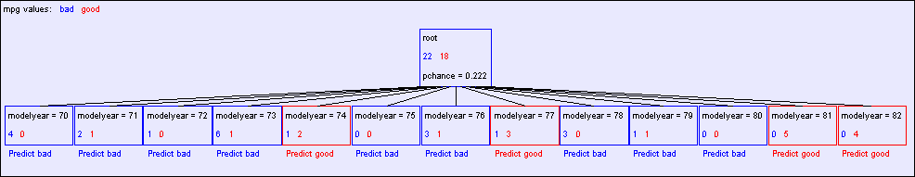
“One branch for each numeric value” idea:
Hopeless: with such high branching factor will shatter the dataset and over fit
Note pchance is 0.222 in the above…if MaxPchance was 0.05 that would end up pruning away to a single root node.
Copyright © Andrew W. Moore
Slide 83
A better idea: thresholded splits
Suppose X is real valued.
Define IG(Y|X:t) as H(Y) - H(Y|X:t)
Define H(Y|X:t) =
H(Y|X < t) P(X < t) + H(Y|X >= t) P(X >= t)
IG(Y|X:t) is the information gain for predicting Y if all you know is whether X is greater than or less than t
Then define IG*(Y|X) = max_{t} IG(Y|X:t)
For each real-valued attribute, use IG*(Y|X)
for assessing its suitability as a split
Copyright © Andrew W. Moore
Slide 84

Slide 43
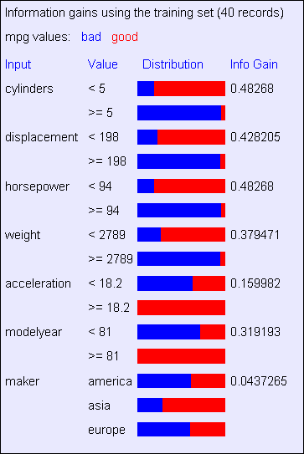
Computational Issues
You can compute IG*(Y|X) in time
R log R + 2 R n_{y}
Where
R is the number of records in the node under consideration
n_{y} is the arity (number of distinct values of) Y
How?
Sort records according to increasing values of X. Then create a 2xn_{y} contingency table corresponding to computation of IG(Y|X:x_{min}). Then iterate through the records, testing for each threshold between adjacent values of X, incrementally updating the contingency table as you go. For a minor additional speedup, only test between values of Y that differ.
Copyright © Andrew W. Moore
Slide 85
Example with MPG
Copyright © Andrew W. Moore
Slide 86

Slide 44
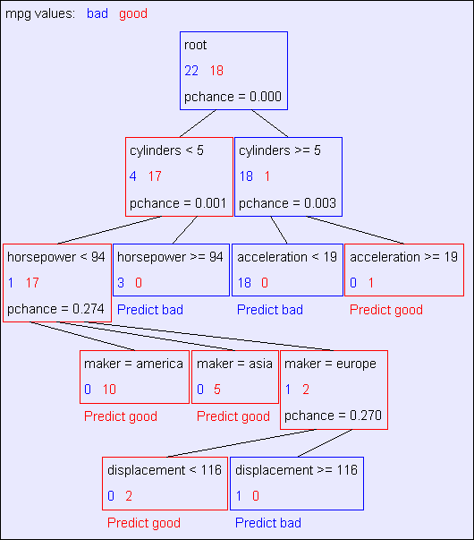
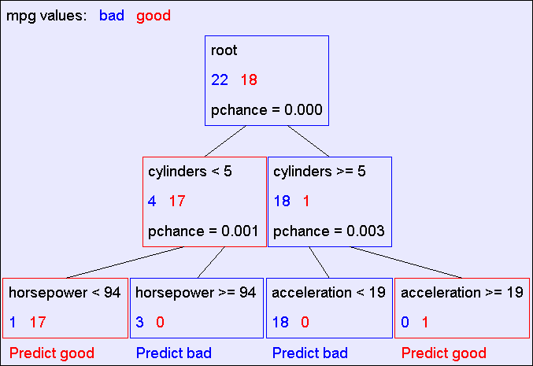
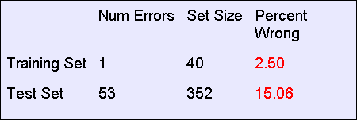
Unpruned tree using reals
Copyright © Andrew W. Moore
Slide 87
Pruned tree using reals
Copyright © Andrew W. Moore
Slide 88

Slide 45
LearnUnprunedTree(X,Y)
Input: X a matrix of R rows and M columns where X_{ij} = the value of the j’th attribute in the i’th input datapoint. Each column consists of either all real values or all categorical values.
Input: Y a vector of R elements, where Y_{i} = the output class of the i’th datapoint. The Y_{i} values are categorical. Output: An Unpruned decision tree
If all records in X have identical values in all their attributes (this includes the case where R<2), return a Leaf Node predicting the majority output, breaking ties randomly. This case also includes
If all values in Y are the same, return a Leaf Node predicting this value as the output Else
For j = 1 .. M
If j’th attribute is categorical IG_{j} = IG(Y|X_{j})
Else (j’th attribute is real-valued)
IG_{j} = IG*(Y|X_{j}) from about four slides back Let j* = argmax_{j} IG_{j} (this is the splitting attribute we’ll use) If j* is categorical then
For each value v of the j’th attribute
Let X^{v} = subset of rows of X in which X_{ij} = v. Let Y^{v} = corresponding subset of Y Let Child^{v} = LearnUnprunedTree(X^{v},Y^{v})
Return a decision tree node, splitting on j’th attribute. The number of children equals the number of values of the j’th attribute, and the v’th child is Child^{v}
Else j* is real-valued and let t be the best split threshold
Let X^{LO} = subset of rows of X in which X_{ij} <= t. Let Y^{LO} = corresponding subset of Y Let Child^{LO} = LearnUnprunedTree(X^{LO},Y^{LO})
Let X^{HI} = subset of rows of X in which X_{ij} > t. Let Y^{HI} = corresponding subset of Y Let Child^{HI} = LearnUnprunedTree(X^{HI},Y^{HI})
Return a decision tree node, splitting on j’th attribute. It has two children corresponding to whether the j’th attribute is above or below the given threshold.
Copyright © Andrew W. Moore Slide 89
LearnUnprunedTree(X,Y)
Input: X a matrix of R rows and M columns where X_{ij} = the value of the j’th attribute in the i’th input datapoint. Each column consists of either all real values or all categorical values.
Input: Y a vector of R elements, where Y_{i} = the output class of the i’th datapoint. The Y_{i} values are categorical. Output: An Unpruned decision tree
If all records in X have identical values in all their attributes (this includes the case where R<2), return a Leaf Node predicting the majority output, breaking ties randomly. This case also includes
If all values in Y are the same, return a Leaf Node predicting this value as the output Else
For j = 1 .. M
If j’th attribute is categorical IG_{j} = IG(Y|X_{j})
Else (j’th attribute is real-valued)
IG_{j} = IG*(Y|X_{j}) from about four slides back Let j* = argmax_{j} IG_{j} (this is the splitting attribute we’ll use) If j* is categorical then
For each value v of the j’th attribute
Let X^{v} = subset of rows of X in which X_{ij} = v. Let Y^{v} = corresponding subset of Y Let Child^{v} = LearnUnprunedTree(X^{v},Y^{v})
Return a decision tree node, splitting on j’th attribute. The number of children equals the number of values of the j’th attribute, and the v’th child is Child^{v}
Else j* is real-valued and let t be the best split threshold
Let X^{LO} = subset of rows of X in which X_{ij} <= t. Let Y^{LO} = corresponding subset of Y Let Child^{LO} = LearnUnprunedTree(X^{LO},Y^{LO})
Let X^{HI} = subset of rows of X in which X_{ij} > t. Let Y^{HI} = corresponding subset of Y Let Child^{HI} = LearnUnprunedTree(X^{HI},Y^{HI})
Return a decision tree node, splitting on j’th attribute. It has two children corresponding to whether the j’th attribute is above or below the given threshold.
Copyright © Andrew W. Moore Slide 90
Things to note:
^{Below the} root node, there is no point
^{testing ca}tegorical attributes that have
^{already been} split upon further up the tree.
^{This is} because all the values of that
^{attribute} will be the same and IG must
therefore be zero.
^{But it’}s worth retesting real-valued
^{attributes, s}ince they may have different
^{values be}low the binary split, and may
benefit from splitting further.
^{To achiev}e the above optimization, you
^{should pass} down through the recursion a
^{cu}rrent active set of attributes.
^{Peda}ntic detail: a third termination
^{conditio}n should occur if the best split
^{attribute put}s all its records in exactly one
child (note that this means it and all other
attributes have IG=0).

Slide 46
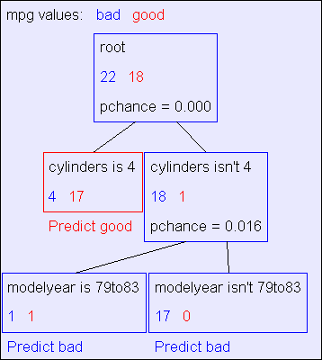
Machine Learning Datasets What is Classification?
Contingency Tables
OLAP (Online Analytical Processing) What is Data Mining?
Searching for High Information Gain
Learning an unpruned decision tree recursively Training Set Error
Test Set Error Overfitting Avoiding Overfitting
Information Gain of a real valued input Building Decision Trees with real Valued Inputs
Andrew’s homebrewed hack: Binary Categorical Splits Example Decision Trees
Copyright © Andrew W. Moore
Slide 91
Warning: unlike what went before, this is an editorial “trick of the
Binary categorical splits
One of Andrew’s
trade”: not part of the official Decision Tree algorithm.
favorite tricks
Allow splits of the following form
Example:
Root
Attribute equals value
Attribute doesn’t equal value
Copyright © Andrew W. Moore
Slide 92

Slide 47
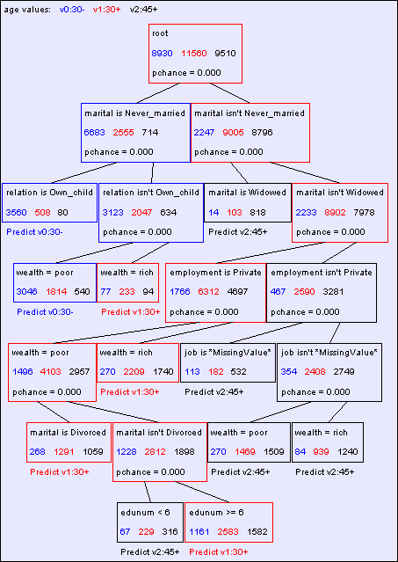
Machine Learning Datasets What is Classification?
Contingency Tables
OLAP (Online Analytical Processing) What is Data Mining?
Searching for High Information Gain
Learning an unpruned decision tree recursively Training Set Error
Test Set Error Overfitting Avoiding Overfitting
Information Gain of a real valued input Building Decision Trees with real valued Inputs
Andrew’s homebrewed hack: Binary Categorical Splits Example Decision Trees
Copyright © Andrew W. Moore
Slide 93
Predicting age from census
Copyright © Andrew W. Moore
Slide 94

Slide 48
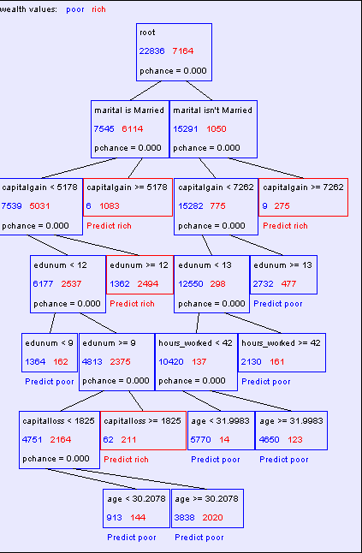
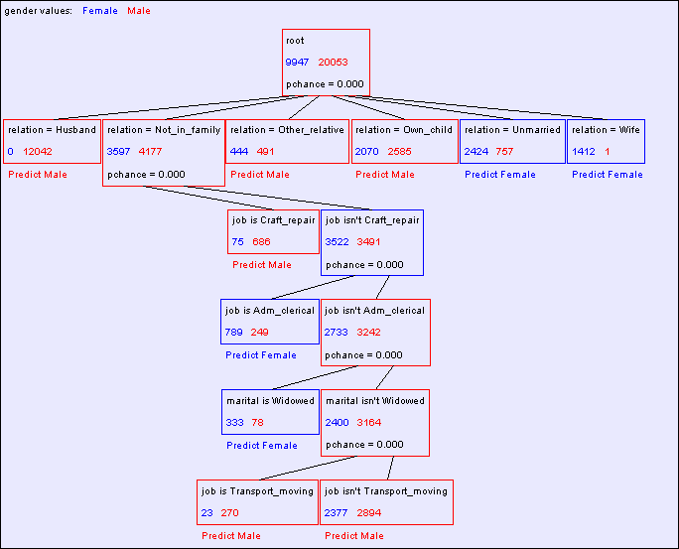
Predicting wealth from census
Copyright © Andrew W. Moore
Slide 95
Predicting gender from census
Copyright © Andrew W. Moore
Slide 96

Slide 49
Conclusions
Decision trees are the single most popular data mining tool
Easy to understand
Easy to implement
Easy to use
Computationally cheap
It’s possible to get in trouble with overfitting
They do classification: predict a categorical output from categorical and/or real inputs
Copyright © Andrew W. Moore
Slide 97
What you should know
What’s a contingency table?
What’s information gain, and why we use it
The recursive algorithm for building an unpruned decision tree
What are training and test set errors
Why test set errors can be bigger than training set
Why pruning can reduce test set error
How to exploit real-valued inputs
Copyright © Andrew W. Moore Slide 98

Slide 50
What we haven’t discussed
It’s easy to have real-valued outputs too---these are called Regression Trees*
Bayesian Decision Trees can take a different approach to preventing overfitting
Computational complexity (straightforward and cheap) *
Alternatives to Information Gain for splitting nodes
How to choose MaxPchance automatically *
The details of Chi-Squared testing *
Boosting---a simple way to improve accuracy *
* = discussed in other Andrew lectures
Copyright © Andrew W. Moore
Slide 99
For more information
Two nice books
L. Breiman, J. H. Friedman, R. A. Olshen, and C. J. Stone. Classification and Regression Trees. Wadsworth, Belmont, CA, 1984.
C4.5 : Programs for Machine Learning (Morgan Kaufmann Series in Machine Learning) by J. Ross Quinlan
Dozens of nice papers, including
Learning Classification Trees, Wray Buntine, Statistics and Computation (1992), Vol 2, pages 63-73
Kearns and Mansour, On the Boosting Ability of Top-Down Decision Tree Learning Algorithms, STOC: ACM Symposium on Theory of Computing, 1996“
Dozens of software implementations available on the web for free and commercially for prices ranging between $50 - $300,000
Copyright © Andrew W. Moore
Slide 100

Slide 51
Discussion
Instead of using information gain, why not choose the splitting attribute to be the one with the highest prediction accuracy?
Instead of greedily, heuristically, building the tree, why not do a combinatorial search for the optimal tree?
If you build a decision tree to predict wealth, and marital status, age and gender are chosen as attributes near the top of the tree, is it reasonable to conclude that those three inputs are the major causes of wealth?
..would it be reasonable to assume that attributes not mentioned in the tree are not causes of wealth?
..would it be reasonable to assume that attributes not mentioned in the tree are not correlated with wealth?
Copyright © Andrew W. Moore Slide 101

